Slide 1
In Class Topic
Databases and Lightweight Technologies by Eric Buhr

Slide 2

Article
Source: PCWorld
Title: MarkLogic buddies up to JavaScript; throws shade at old pal XML
Author: Joab Jackson
date: 02/09/15

Slide 3

MarkLogic
Founded in 2001
Leading provider of NoSQL databases
Traditionally XML-based technology
Client work: Healthcare.gov, Congressional Quarterly, Elisever and Conde Nast

Slide 4
NoSQL
Developed in response to SQL, very popular relational database
Does not require SQL standards or all queries
Confusion with the term- Not only SQL
Better performance, availability, scalability and flexibility
Big Data projects
White Paper “Why NoSQL?” by datastax.com

Slide 5
MarkLogic Server 8
Same functionality as XML version
Works natively with JavaScript and JSON
Supports Sparql, query language for rich Semantic web documents
Bitemporality – multiple date stamps

Slide 6
Move to JSON
MySQL, MongoDB, PostgreSQL, MS SQL Server, Oracle and others have done this
“How JSON sparked No SQL” by Ryan Betts InfoWorld

Slide 7
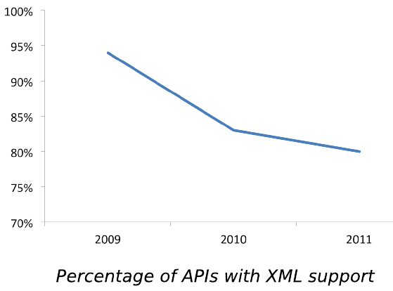
XML trends downward
1 in 5 APIs Say "Bye XML“ , www.programmableweb.com
Adam DuVander May. 25 2011, 08:00AM EDT

Slide 8
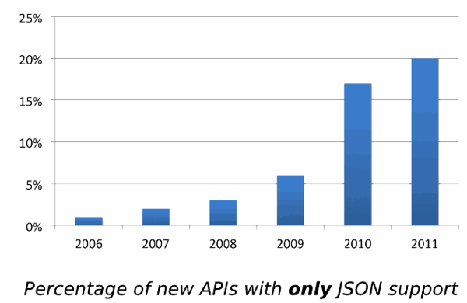
JSON on upswing

Slide 9
Why?
Overall lack of adoption of XML
Must learn XML scripts
More complex format-multiple conversions
Additional translation layer
JSON is widely popular
Simple data format (easy to learn)
Easy to use (translate across platforms)
Serialization format for exchanging data between applications

Slide 10
Example of a JSON file
{
"colorsArray":[{
"colorName":"red",
"hexValue":"#f00"
},
{
"colorName":"blue",
"hexValue":"#00f"
},
{
"colorName":"black",
"hexValue":"#000"
}
]
}

Slide 11
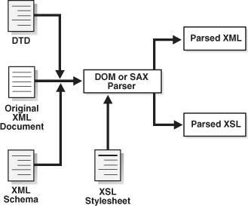
XML processing

Slide 12
Firms like MarkLogic
According to Tim O’Reilly’s article, "What is Web 2.0"
Poised for success now and in the future
Data is the next Intel Inside
More lightweight programming models
Also mentioned by O’Reilly in “Web Squared: Five Years On”
Providing support for Semantic web (possible element of Web 3.0?)

Slide 13
My thoughts
Trend is a boon for developers more lightweight and simpler solutions
Less time wrestling with back-end tools
More time on design and architecture
Increased focus on solving the customer’s problem on the front-end
Also helps customers -- easier to use and deal with these applications
MarkLogic made their bet for Semantic web

Slide 14
Glossary
XML (Extensible Markup Language) - a markup language for the web that defines a set of rules for encoding documents .
JSON (JavaScript Object Notation) - an open standard data format that uses human-readable text.
JavaScript - dynamic client-side scripting langauge that provides interactivity with web users (not Java).
Big Data - broad term for data sets so large or complex that they are difficult to process using traditional applications.
Semantic Web –standard promoted by W3C for a common framework of data to be shared and reused across application, enterprise, and community boundaries ( Tim Berners-Lee-to describe “a web of data that can be processed by machines”).

